Slide 1
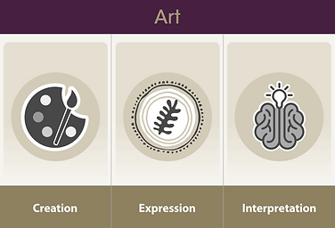
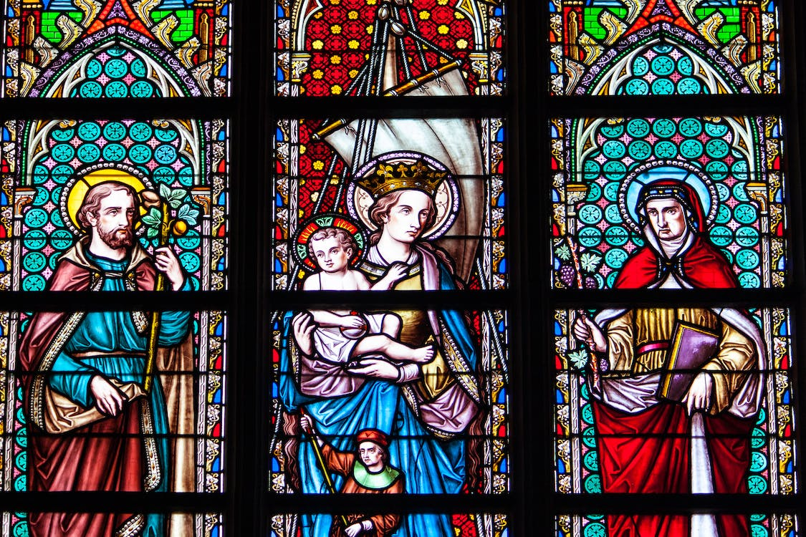
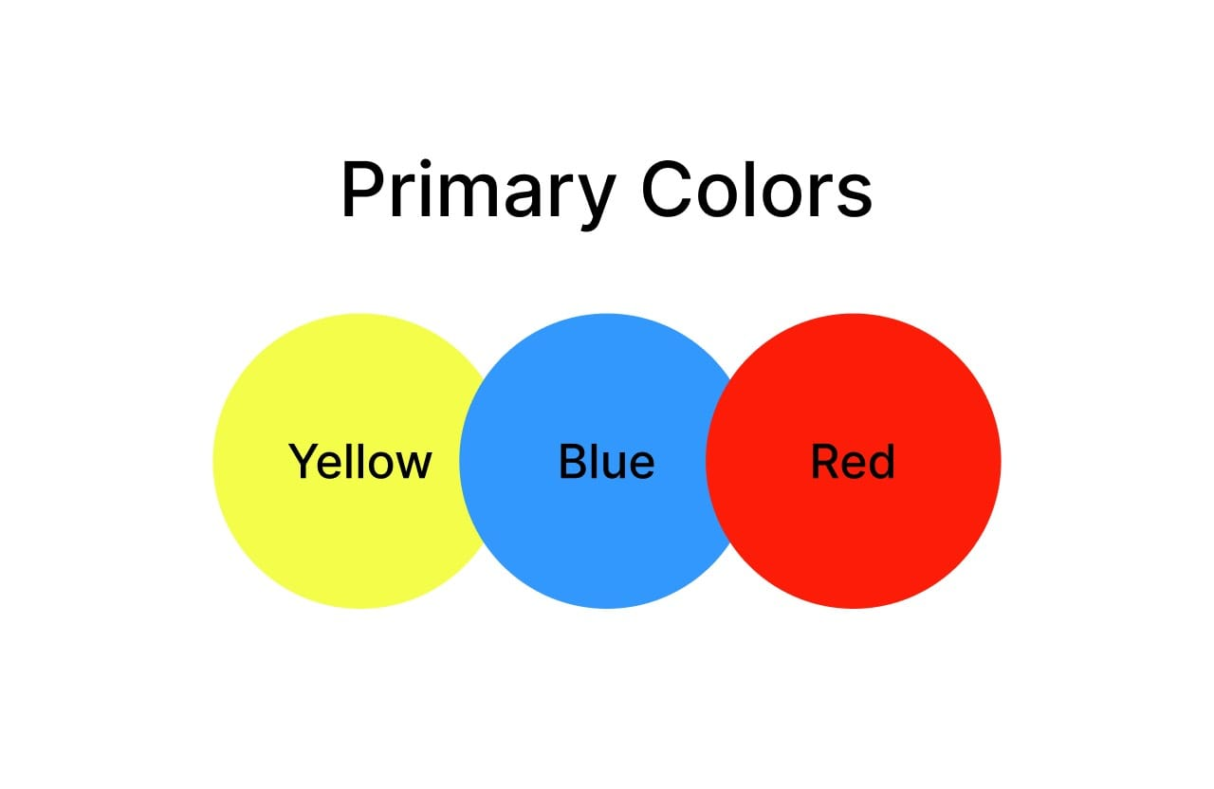
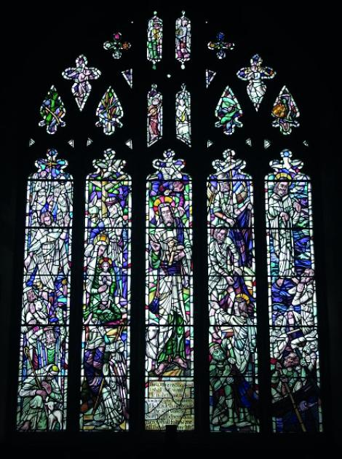
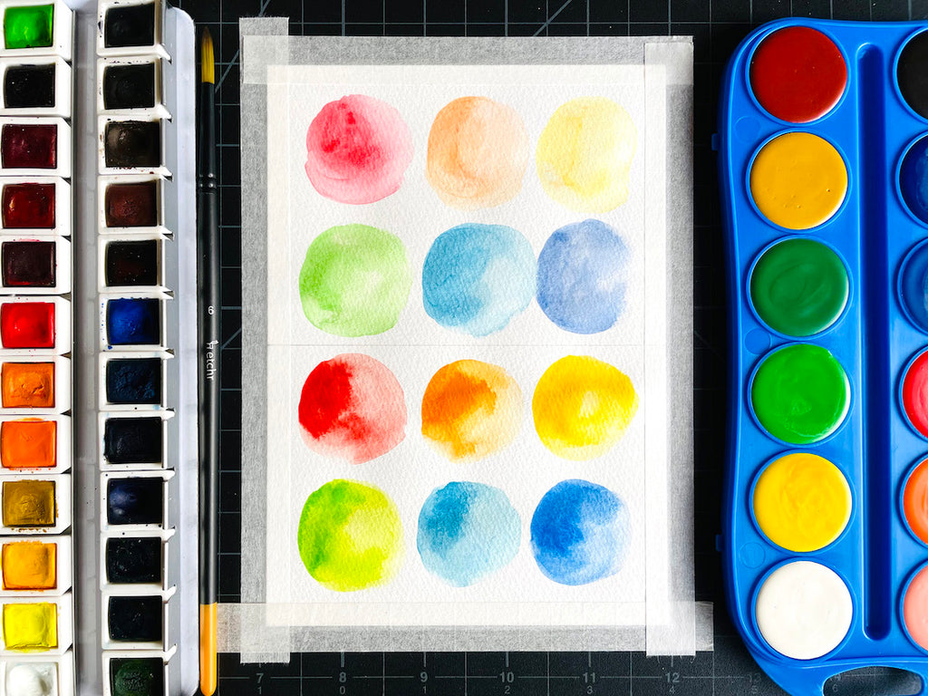
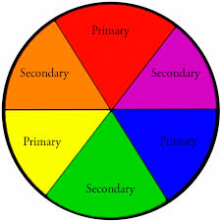
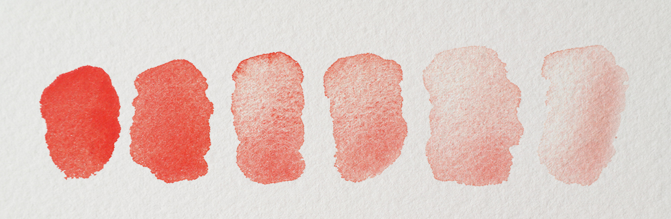
Why is legacy important?
Art LEARNING organiser YEAR 2
Art vocabulary
Combine | To mix together.
Secondary | Being second.
Tones | A shade of colour.
Brush | A painting tool.
Wash | Cover lightly so you cannot see the individual brush stroke.
End of Enquiry Learning
I will show the development of my ideas I will create images both real and imagined I will know secondary colours are I know how to mix paint to form tones I know how to select media to fill a space

