Slide 1
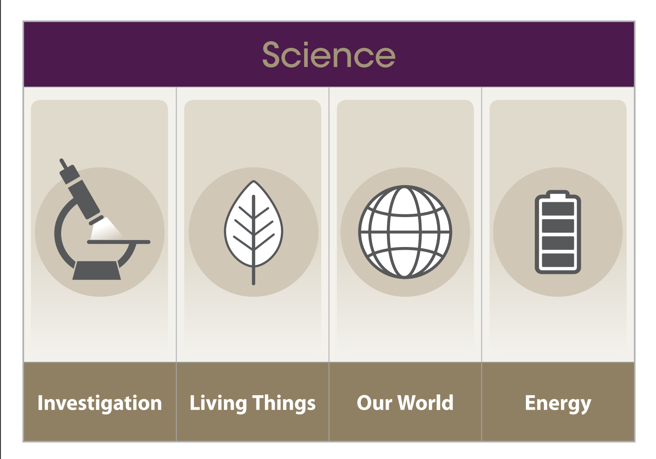
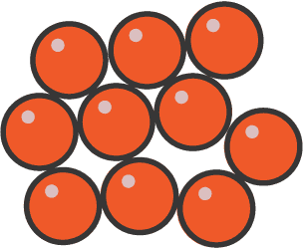
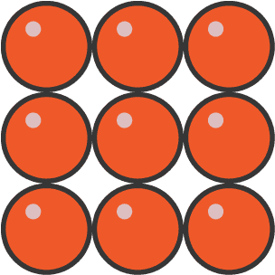
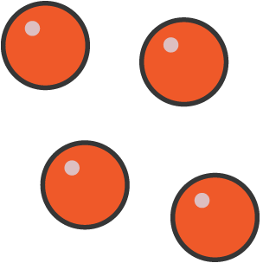
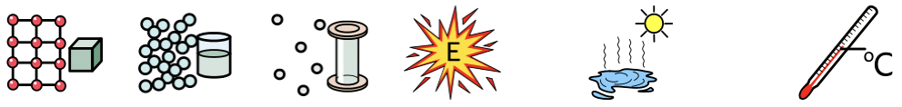
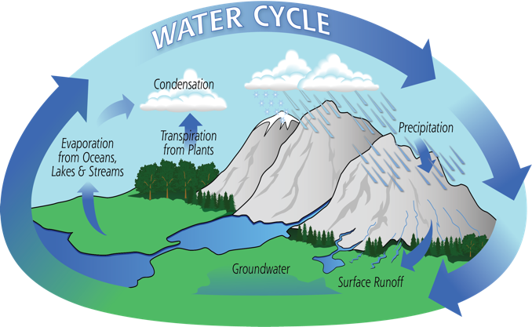


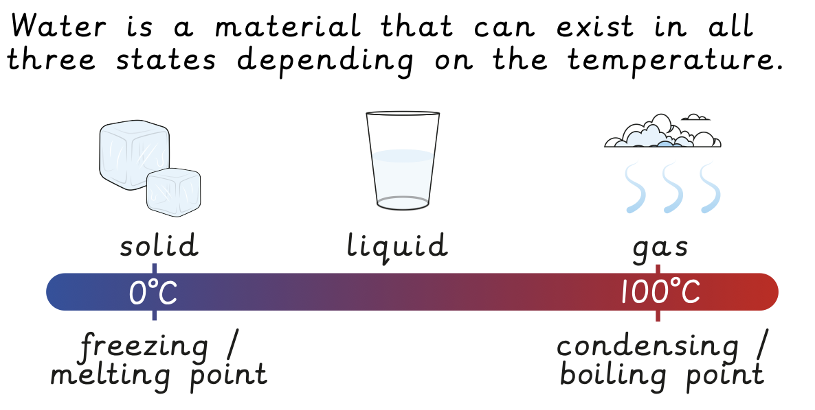
How does temperature affect the water cycle?
SCIENCE LEARNING organiser YEAR 3
Vocabulary
 | Solid | Something that has a shape and does not flow, like a rock or ice.
 | Liquid | Something that can flow and take the shape of its container, like water or milk.
 | Gas | Something that spreads out to fill the space it’s in, like air or steam.
 | Energy | The power to make things happen, like heat, light, or movement.
 | Evaporating | When a liquid turns into a gas, like water turning into steam.
 | Temperature | How hot or cold something is.
 | Celsius | A way to measure temperature, where 0°C is freezing and 100°C is boiling.
 | Condensation | When gas cools down and turns into liquid, like water droplets on a cold glass.
 | Precipitation | Water that falls from the sky, like rain, snow, or hail.
 | Cloud | A group of tiny water droplets or ice crystals in the sky.
Melt
Evaporate
SOLID
LIQUID
GAS
End of Enquiry Learning
I know what solids, liquids or gases are. I know the stages of the water cycle. I know different temperatures effect different materials and how to measure temperature. I know how water evaporates. I know how temperature effects the rate of evaporation. I can explain which variable I have changed, which ones I have kept the same and why. I can give a reason for why my test was fair I can use simple scientific apparatus such as thermometers, rulers, magnified glass, measuring jugs, scales.
Freeze
Condense

