Slide 1
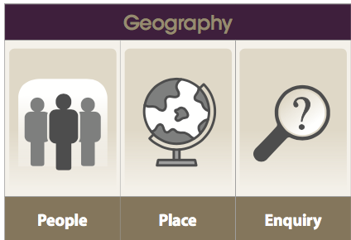
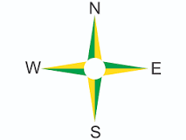
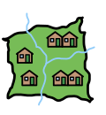
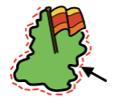
How can I use maps to find out about the UK?
Geography LEARNING organiser YEAR 2
Vocabulary
1 | County | A small area of the UK containing lots of towns and villages.
2 | United Kingdom (UK) | The United Kingdom of Great Britain and Northern Ireland. Great Britain England, Scotland and Wales.
3 | Landmark | A feature of the land or area that is well known or easily recognised
4 | Country | Land that is controlled by a government.
5 | City | A large town where many people live closely together and a cathedral.
6 | Nationality | A person’s nationality tells which country that person is from.
7 | Border | The edge or boundary of an area.
8 | Coast | The area where the sea and the land meet.
End of Enquiry Learning
I know where the United Kingdom is. I know the countries that make up the UK. I know some of the major UK cities and the capital cities. I know some of the main rivers. I know some of the different features and landmarks. I can use an OS map. I can use a key. I can write descriptions of UK landmarks. I can ask and answer questions about the United Kingdom.

