Slide 1
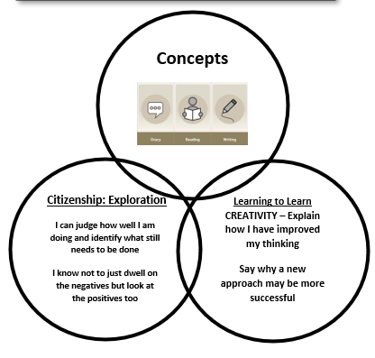


Year 4 Geography
Vocabulary
Volcano | A mountain that forms when magma (hot, melted rock) from inside the Earth rises to the surface and erupts as lava, ash, and gases.
Resilience | The ability of people or communities to recover and rebuild after a natural disaster
Tectonic Plates | Huge pieces of the Earth’s crust that fit together like a jigsaw and slowly move. When they move or collide, they can cause earthquakes and volcanoes.
Eruption | When lava, ash, and gases burst out from a volcano.
Fertile Soil | Soil that is rich in minerals and nutrients, making it excellent for growing crops.
Why are so many volcanoes near communities? (A study of Indonesia)
Outcome:
By the end of our learning journey, pupils will create an infographic page explaining why communities live near volcanoes in Indonesia, including geographical, environmental, and human reasons.
Knowledge:
What risk factors are e.g threat to life, changing landscapes
What the risk factors of this region are
What action has been taken to limit risk e.g materials for house building, fire breaks, flood defences
What future implications for this region might be
Skills:
Evaluate different ways of presenting my work and consider the advantages and disadvantages of these prior to making a final choice.
Use a topographical map of Europe to identify features of countries
Ask questions about how physical features were formed or changed

